Slide 1

Used Cars Price Prediction An Avalon’s team project
SUBMITTED TO
Dr. Reza Sadeghi

Slide 2
Outline
Team Members
Introduction
Dataset Description
Related Work
Project Plan
Data Exploration
Univariate Analysis
Bivariate Analysis
Data Modeling
Residual Analysis
Evolution
Final Result Comparison

Slide 3
Team Members
Samba Chennamsetty – Team Head
Arif Pasha Shaik – Team Member
Jagadishwar Reddy Velma – Team Member
Sai Hrithik Peddi– Team Member
Vamsi Kiran Kakkera - Team Member
Kaki Rohit Reddy– Team Member

Slide 4
Introduction
As the world evolving in all directions significantly, the economic gaps between the people still exist. The livelihood of different people from different financial backgrounds are changing a lot. When it comes to the comfortable travel the cars are playing a vital role. Also, considering the COVID pandemic, most of the lower- and middle-income group of people also attracting to travel in a safe environment and not willing to choose public transport.
At the same time the car manufacturers also increased the price of the new cars, which is directly affecting the buying capability of low-income group people.
Hence, most of the people are looking at the used cars now.
There are few people who cannot afford to buy new luxury car, but they wish to travel in it. For those, this used cars are the sunlight in dark. [1]
This used cars has become an opportunity for the business. And it's going to generate a decent revenue for business as well.

Slide 5
Dataset DESCRIPTION
This dataset contains information about used cars listed on www.cardekho.com
This data can be used for a lot of purposes such as price prediction to exemplify the use of linear regression in Machine Learning.
Old Car Selling Price with Linear Regression
Car_Name
Year
Selling_Price
Present_Price
Kms_Driven
Fuel_Type
Seller_Type
Transmission
Owner

Slide 6
Related Work
We are comparing this model with car prediction prices which has multi linear regression with less no of dependencies and models.
Pro’s
The advantages we have over the other related works are
Using linear regression model allows us to make our analysis simple.
Providing a variety of visual representations of impact with each feature.
It is planned to build multiple models based on type of company.
Considering the best prediction relational fields.

Slide 7
Project Plan
The project plan has the below steps in it.
Data-preprocessing
Model building
Optimizing Model
Model Evaluation

Slide 8
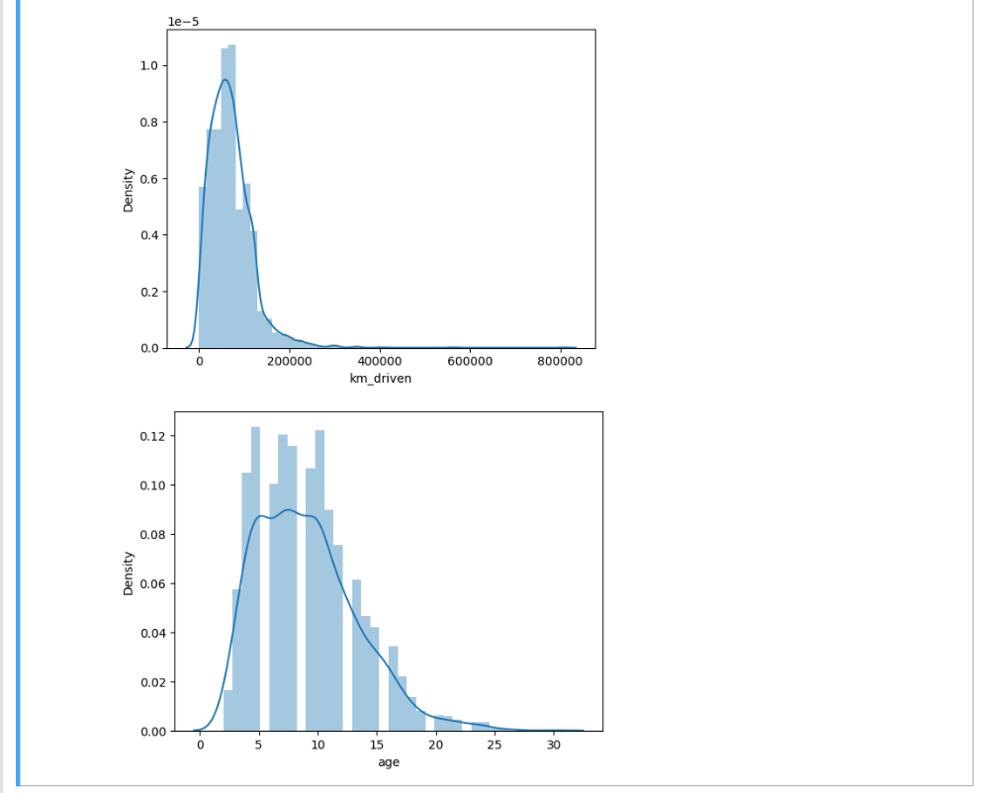
Data Exploration
Univariate Analysis:
Univariate analyses are used extensively in quality-of-life research. Univariate analysis is defined as analysis carried out on only one (“uni”) variable (“variate”) to summarize or describe the variable.
However, another use of the term “univariate analysis” exists and refers to statistical analyses that involve only one dependent variable and which are used to test hypotheses and draw inferences about populations based on samples, also referred to as univariate.

Slide 9
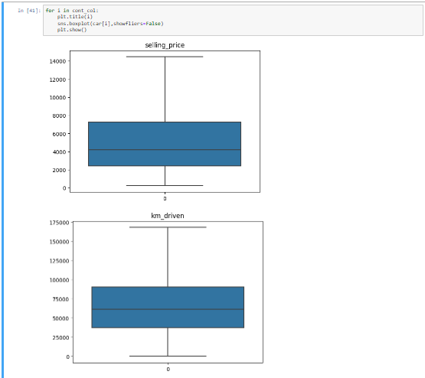
Boxplot
Boxplot - A graphical rendition of statistical data based on the minimum, first quartile, median, third quartile, and maximum.
In the fig 7 the observation states that the first quartile lies at the lower end of the box and the upper end is the 3rd quartile. The box indicates the range in which the middle 50% of all the data lies.
The line in between the first quartile and the third quartile lies the median. (Median in the boxplot represents with solid line and the Mean in the boxplot represents with dashed line)

Slide 10
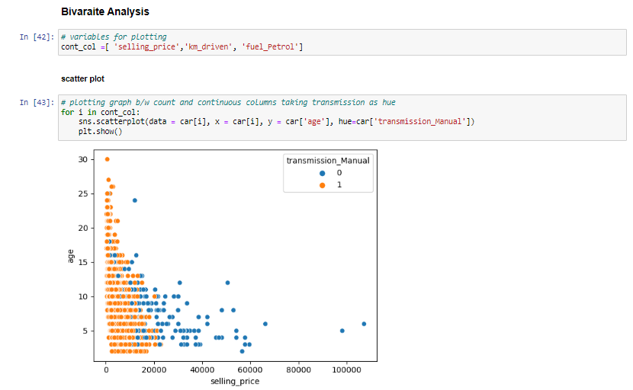
Bivariate Analysis
Bivariate analysis refers to the analysis of two variables to determine relationships between them. Bivariate analyses are often reported in quality-of-life research. For an excellent example of research that utilizes bivariate analyses and demonstrates how the results of bivariate analyses can be used to inform furthermore complex analyses.
We find the relation between Selling Price and Car age which is bi with scatter plotting.
Here we can notice that as the age goes up the selling prices decreases.
And most of the manual transmission cars are under the age 15 and price range of 20000.

Slide 11
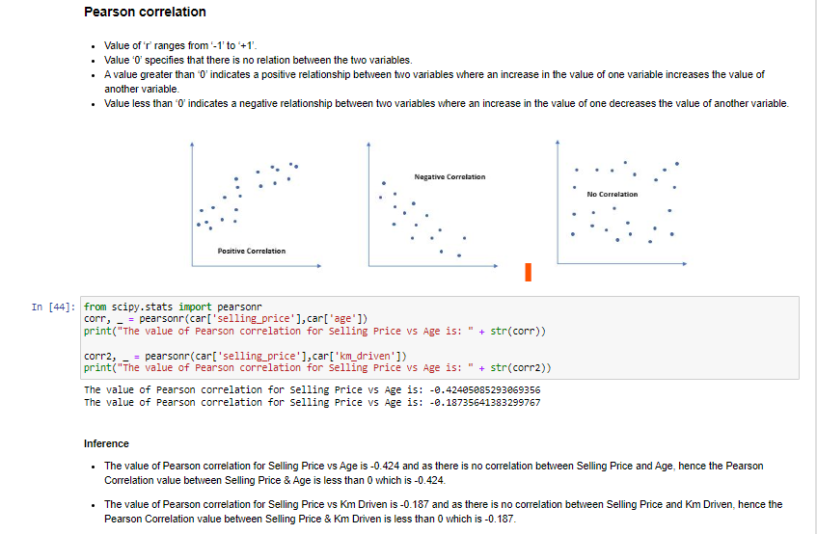
Pearson Correlation
Pearson's correlation coefficient is the covariance of the two variables divided by the product of their standard deviations.
The form of the definition involves a "product moment", that is, the mean (the first moment about the origin) of the product of the mean-adjusted random variables; hence the modifier product-moment in the name.
A value greater than ‘0’ indicates a positive relationship between two variables where an increase in the value of one variable increases the value of another variable.
Value less than ‘0’ indicates a negative relationship between two variables where an increase in the value of one decreases the value of another variable.

Slide 12
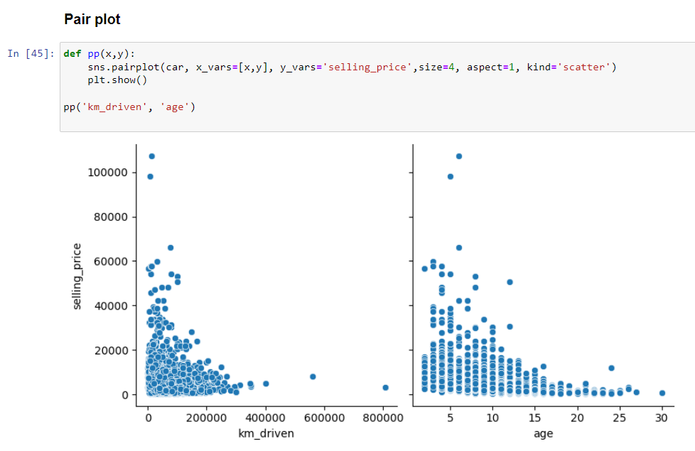
Pair plot
Selling price is compared with kms driven and age of the car.
The pair plot graphs portray the comparison between selling price and kms driven along with age.
Here, the observation states that the increase in kms driven makes the selling price decrease, vice-versa i.e., data shown in fig.
The car that has driven 800000 kms has a selling price of 0. Whereas highest selling price which is more than 100000 has only driven very less (near to 0 or 10000)

Slide 13
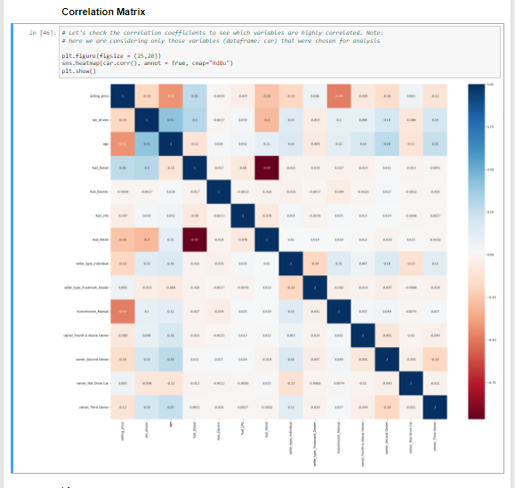
Correlation Matrix
A correlation heatmap is a graphical representation of a correlation matrix representing the correlation between different variables.
The value of correlation can take any value from -1 to 1. Correlation between two random variables or bivariate data does not necessarily imply a causal relationship.

Slide 14
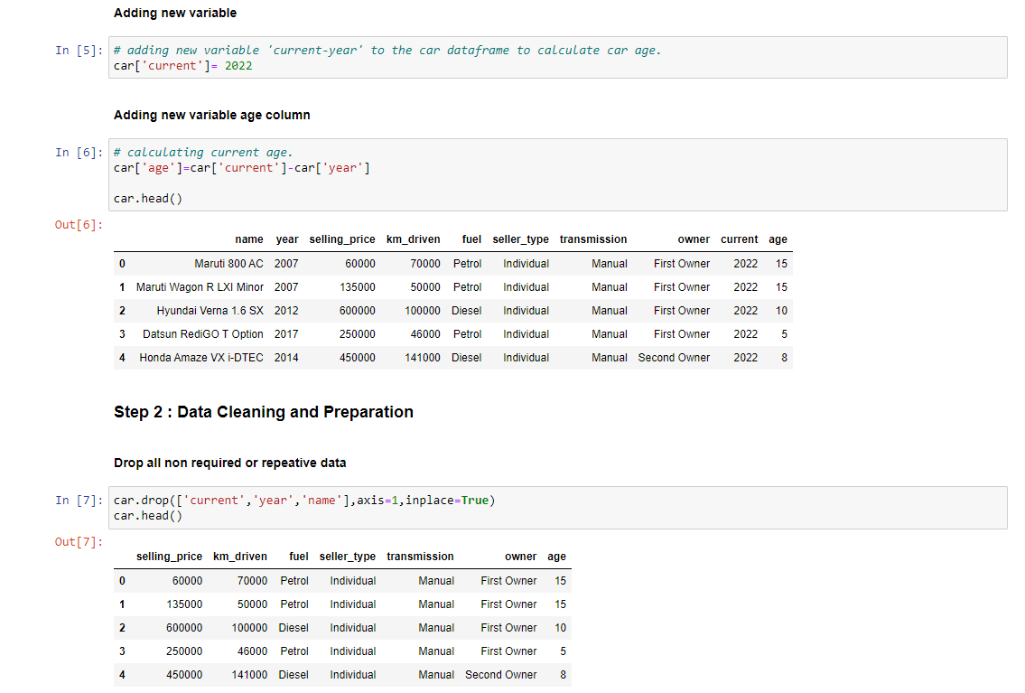
Data Splitting
Adding a new variable for calculating the age of the car.
As part of this we clean the unwanted data and make the data right and good for the model with error free.
Dropping all non required or repeative data using the .drop function.

Slide 15
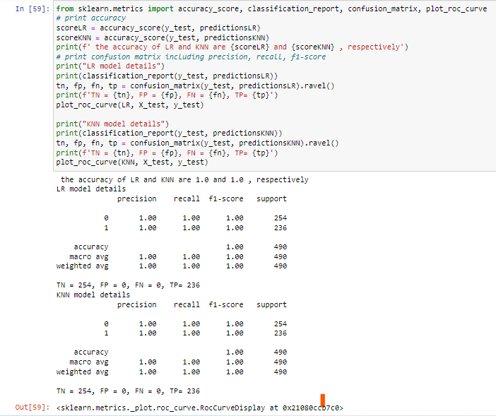
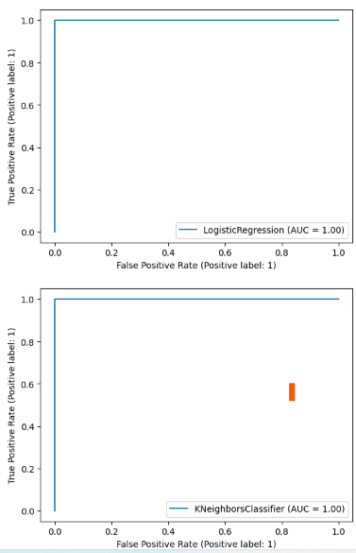
Measuring Performance
Plot ROC Curve
ROC curves in logistic regression are used for determining the best cutoff value for predicting whether a new observation is a "failure" (0) or a "success" (1).

Slide 16
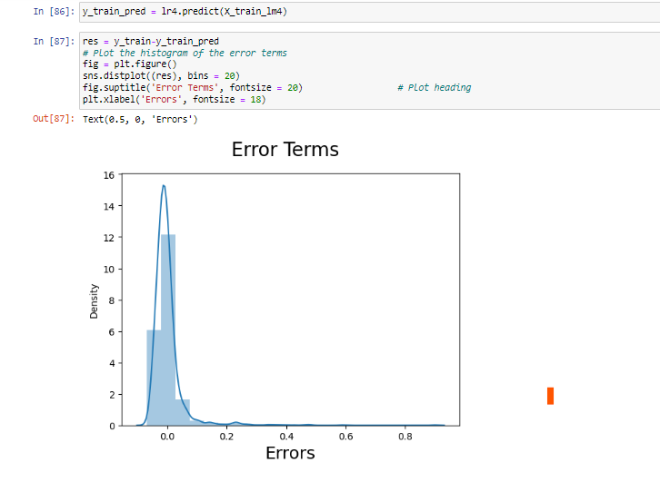
Residual Analysis
We plot the graph to find the error terms of the model w.r.t prediction value of price.
The error graph shows the increase in the density and drops down when error is increased.
So, at 0 the density is high and it is distributed normally.
From the given histogram, we could see that the Residuals are normally distributed. Hence our assumption for Linear Regression is valid.

Slide 17
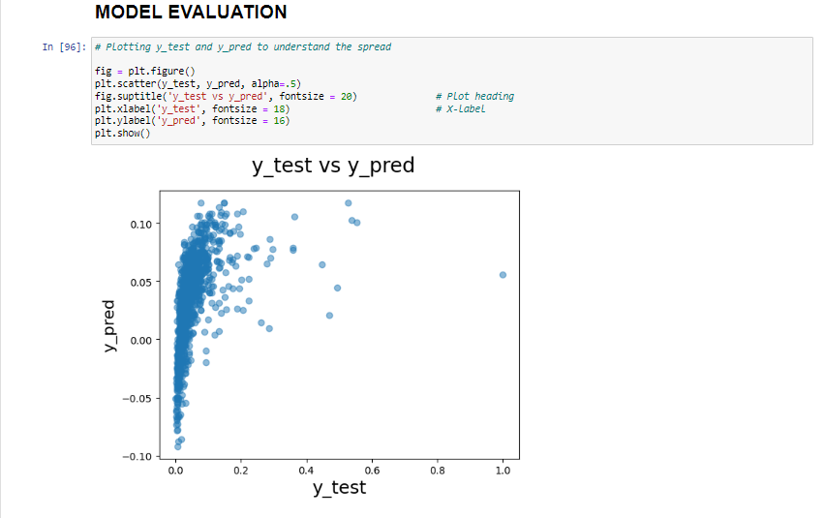
Evolution
Evaluate the actual price and predicted price with the results obtained by plotting the graph with graphical representation.
We can observe how the actual and predicted prices has variance we can see a few outliers on the top right with high variance.

Slide 18
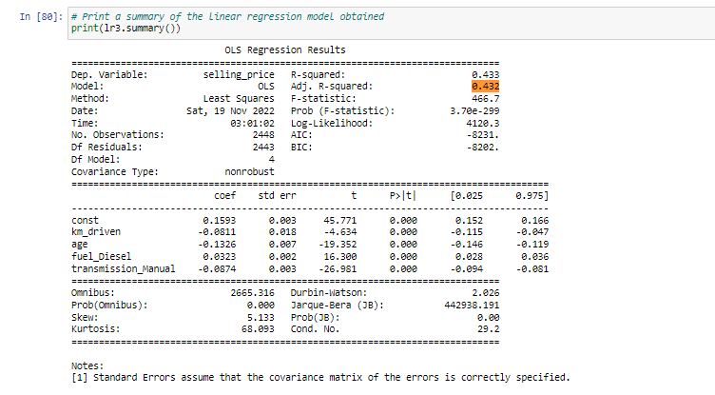
Final Result Comparison
As per our final Model, the top predictor variables that influences the selling_price are:
km_driven: A coefficient value of ‘0.081104’ indicated that a unit increase in km_driven variable, decreases the selling_price numbers by 0.081104 units.
age: A coefficient value of ‘-0.132559’ indicated that, a unit increase in age variable, decreases the selling_price numbers by 0.132559 units.
fuel_Diesel: A coefficient value of ‘0.032289’ indicated that w.r.t Petrol, a unit increase in fuel_Diesel variable increases the selling_price numbers by 0.032289 units.
transmission_Manual: A coefficient value of ‘-0.087353’ indicated that w.r.t Automatic, a unit increase in transmission_Manual variable decreases the selling_price numbers by 0.087353 units.

Slide 19
GITHUB REFERENCE
https://github.com/samba-chennamsetty/used-car-selling-price-linear-regression

Slide 20

Any questions ?

Slide 21
Thank you…!

